Slide 1


Introduction to Computer Security
Substitution ciphers
CS471
Lecture 2 Caesar cipher & Vernam cipher
By:
Dr. Hussien M. Sharaf

Slide 2
Caesar cipher
The Caesar cipher is a substitution technique that shifts each letter of the plaintext by number of places which is the key to produce the ciphertext.
X Y Z A B C D E F
encryption
A B C D E F G H I
decryption
X Y Z A B C D E F
Dr. Hussien M. Sharaf
2

Slide 3
Caesar algorithm parameters
Caesar encryption:
Key (k)
Plaintext (p)
Caesar decryption:
Key (-k)
Ciphertext (c)
Dr. Hussien M. Sharaf
3

Slide 4
Caesar algorithm
Encryption algorithm:
For each character in plaintext p
c = (p + k) Mod alphabet_count
End for
Decryption algorithm:
For each character in ciphertext c
if (c - k) < 0 then
p = c – k + Alphabet_Count
else
p = c – k
End for
Dr. Hussien M. Sharaf
4

Slide 5
Example 1
If we have K = 3
If we assign a numerical equivalent to each letter then the transformation of p to c will be:
P: a b c d e f g h I j k l m n o p q r s t u v w x y z
C: d e f g h I j k l m n o p q r s t u v w x y z a b c
a b c d e f g h i j k l m
0 1 2 3 4 5 6 7 8 9 10 11 12
n o p q r s t u v w x y z
13 14 15 16 17 18 19 20 21 22 23 24 25
Dr. Hussien M. Sharaf
5

Slide 6
Example 1 (cont.)
Encrypt the following message with k = 3
P = fox faster than dog
Using the equation c = (p + k) Mod 26
Note: in this example alphabet_count = 26, and k takes on a value in the range 0 to 25.
a b c d e f g h i j k l m
0 1 2 3 4 5 6 7 8 9 10 11 12
n o p q r s t u v w x y z
13 14 15 16 17 18 19 20 21 22 23 24 25
Then ciphertext will be:
C = ira idvwhu wkdq grj
Dr. Hussien M. Sharaf
6

Slide 7
Example 1 (cont.)
To Decrypt the ciphertext with k = 3
C = ira idvwhu wkdq grj
Using the decryption algorithm:
if (c - k) < 0 then
p = c – k + 26
else
p = c - k
Then plaintext will be:
P = fox faster than dog
Dr. Hussien M. Sharaf
7

Slide 8
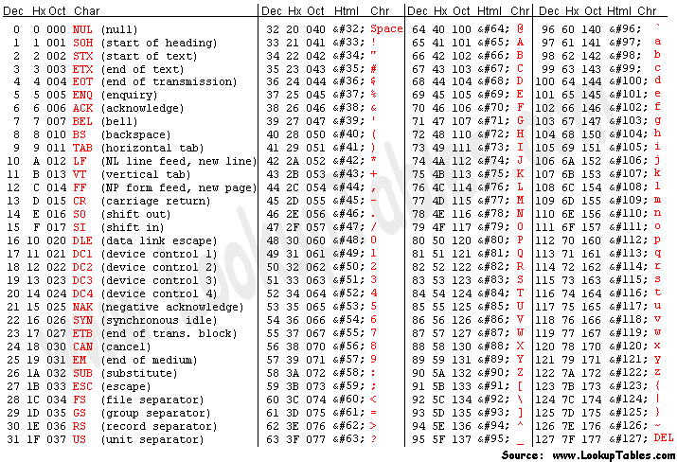
Ascii codes table

Slide 9
Example 2
Encrypt the following message using ascii code table with k = 5
P = Is fox faster than dog?
Using the equation c = (p + k) Mod 127
Note: in this example Alphabet_Count = 127 (i.e the number of characters in the ascii code table), and k takes on a value in the range 1 to 127.
Then ciphertext will be:
C = Nx%kt}%kfxyjw%ymfs%itlD
Dr. Hussien M. Sharaf
9

Slide 10
Example 2 (cont.)
To Decrypt the ciphertext with k = 5
C = Nx%kt}%kfxyjw%ymfs%itlD
Using the decryption algorithm:
if (c - k) < 0 then
p = c – k + 127
else
p = c - k
Then plaintext will be:
P = Is fox faster than dog?
Dr. Hussien M. Sharaf
10

Slide 11
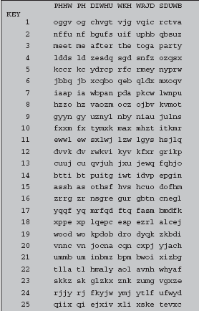
Cryptanalysis
Caesar cipher algorithm is very easy to break, simply try all 25 possible keys to get the plaintext letters.
Dr. Hussien M. Sharaf
11

Slide 12
Assignment #1
Download the “Cryptography/CryptographyProgram.zip” file.
Uncompress the file using winrar.
Target is to build a class to encrypt/decrypt text entered by the user.
Dr. Hussien M. Sharaf
12

Slide 13
Deadline
Next Lecture is the deadline.
No excuses.
Don’t wait until last day.
I can help you to the highest limit within the next 3 days.
Dr. Hussien M. Sharaf
13

Slide 14
Substitution ciphers
Vernam cipher
By:
Dr. Hussien M. Sharaf

Slide 15
Vernam cipher
The vernam cipher is a substitution technique that implements exclusive or operation (^) on each bit of plaintext with the corresponding bit in key, thus the key length must equal to the plaintext length.
It works on binary data (bits) rather than letters.
Dr. Hussien M. Sharaf
15

Slide 16
Ascii codes table
Binary | Dec | character
100 0001 | 65 | A
100 0010 | 66 | B
100 0011 | 67 | C
100 0100 | 68 | D
100 0101 | 69 | E
100 0110 | 70 | F
100 0111 | 71 | G
100 1000 | 72 | H
101 0111 | 87 | W
101 1000 | 88 | X
101 1001 | 89 | Y
101 1010 | 90 | Z
Binary | Dec | character
110 0001 | 97 | a
110 0010 | 98 | b
110 0011 | 99 | c
110 0100 | 100 | d
110 0101 | 101 | e
110 0110 | 102 | f
110 0111 | 103 | g
110 1000 | 104 | h
111 0111 | 119 | w
111 1000 | 120 | x
111 1001 | 121 | y
111 1010 | 122 | z

Slide 17
Binary representation of letters
Each letter in the ascii code table has a decimal number like:
A = 65 a = 97
B = 66 b = 98
The binary representation is such like that:
A = 01000001 a = 01100001
B = 01000010 b = 01100010
Dr. Hussien M. Sharaf
17

Slide 18
Bitwise XOR operator
Compares two bits and returns 1 if either of the bits are 1 and returns 0 if both bits are 0 or 1.
Example:
A ^ b = ?
1000001 (A)
^ 1100010 (b)
0100011 (C)
b1 | b2 | b1 ^ b2
0 | 0 | 0
0 | 1 | 1
1 | 0 | 1
1 | 1 | 0
Dr. Hussien M. Sharaf
18

Slide 19
Vernam algorithm parameters
Vernam encryption:
Key (k)
Plaintext (p)
Vernam decryption:
Key (k)
Ciphertext (c)
Dr. Hussien M. Sharaf
19

Slide 20
Vernam algorithm
Encryption algorithm:
For each character in plaintext p
ci = pi ^ ki
End for
Decryption algorithm:
For each character in ciphertext c
pi = ci ^ ki
End for
Where i means the binary digit of the character.
Dr. Hussien M. Sharaf
20

Slide 21
Example (cont.)
Encrypt the plaintext “Hello” with the key “12345” using vernam algorithm.
Using the encryption algorithm:
ci = pi ^ ki then:
H | e | l | l | o | Plaintext
01001000 | 01100101 | 01101100 | 01101100 | 01101111 | Binary_P
1 | 2 | 3 | 4 | 5 | Key
00110001 | 00110010 | 00110011 | 00110100 | 00110101 | Binary_K
01001000 | 01100101 | 01101100 | 01101100 | 01101111 | Binary_P
00110001 | 00110010 | 00110011 | 00110100 | 00110101 | Binary_K
01111001 | 01010111 | 01011111 | 01011000 | 01011010 | P ^ K
Dr. Hussien M. Sharaf
21

Slide 22
Example (cont.)
Thus the binary representation of the ciphertext is as follows:
01111001 | 01010111 | 01011111 | 01011000 | 01011010 | Binary_C
y | W | _ | X | Z | Ciphertext
Then ciphertext will be:
C = yW_XZ
Dr. Hussien M. Sharaf
22

Slide 23
Example (cont.)
To decrypt the ciphertext “yW_XZ” with the key “12345” using vernam algorithm.
Using the decryption algorithm:
pi = ci ^ ki ,then simply do the reverse operation:
01111001 | 01010111 | 01011111 | 01011000 | 01011010 | Binary_C
00110001 | 00110010 | 00110011 | 00110100 | 00110101 | Binary_K
01001000 | 01100101 | 01101100 | 01101100 | 01101111 | C ^ K
Dr. Hussien M. Sharaf
23

Slide 24
Example (cont.)
Thus the binary representation of the plaintext is as follows:
01001000 | 01100101 | 01101100 | 01101100 | 01101111 | Binary_C
H | e | l | l | o | Ciphertext
Then plaintext will be:
P = Hello
Dr. Hussien M. Sharaf
24

Slide 25
Thank You

